Slide 1
New Student Dashboard Overview

Slide 2
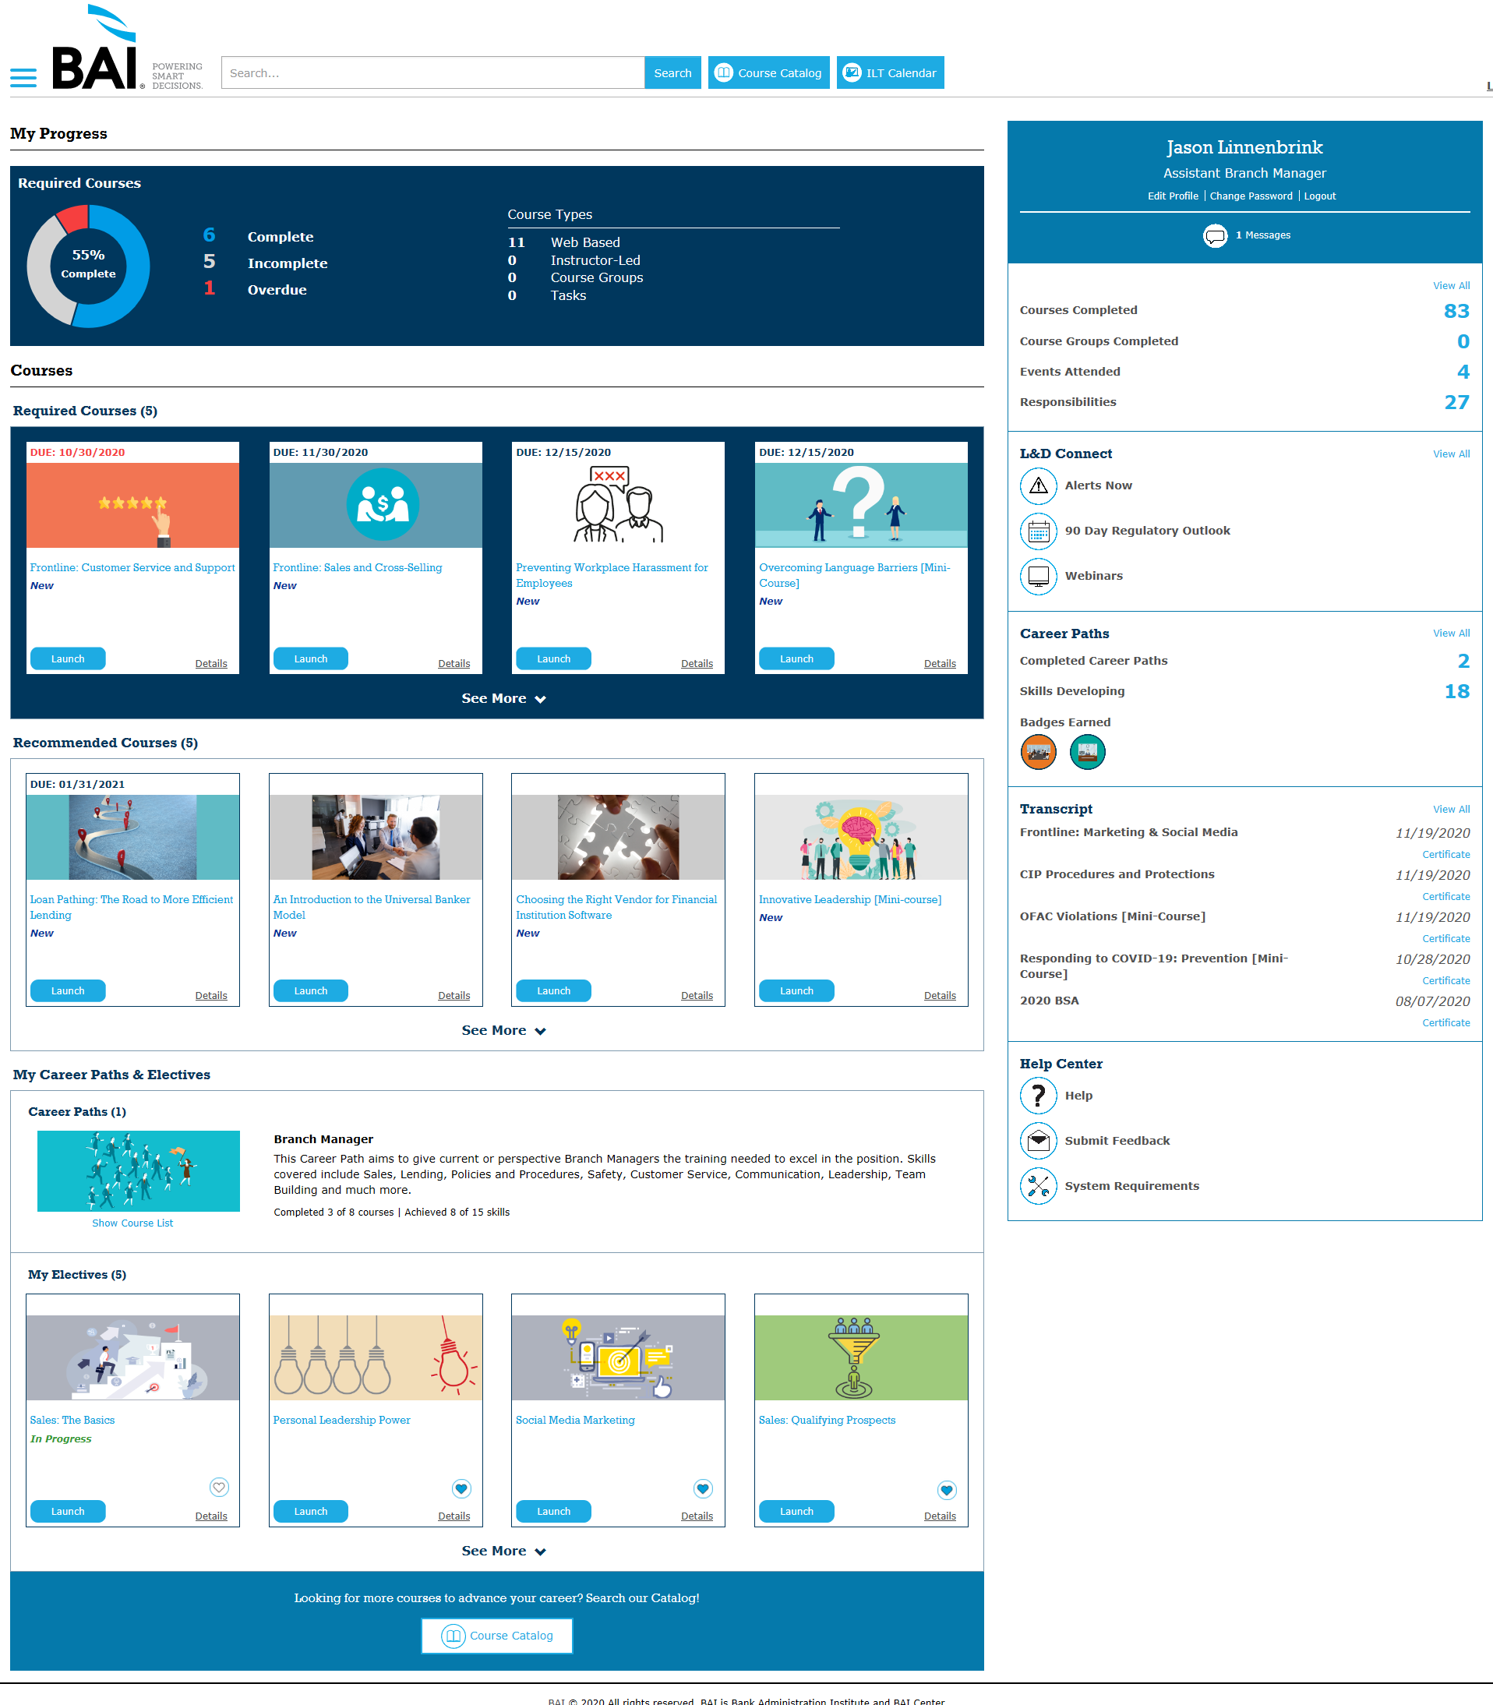
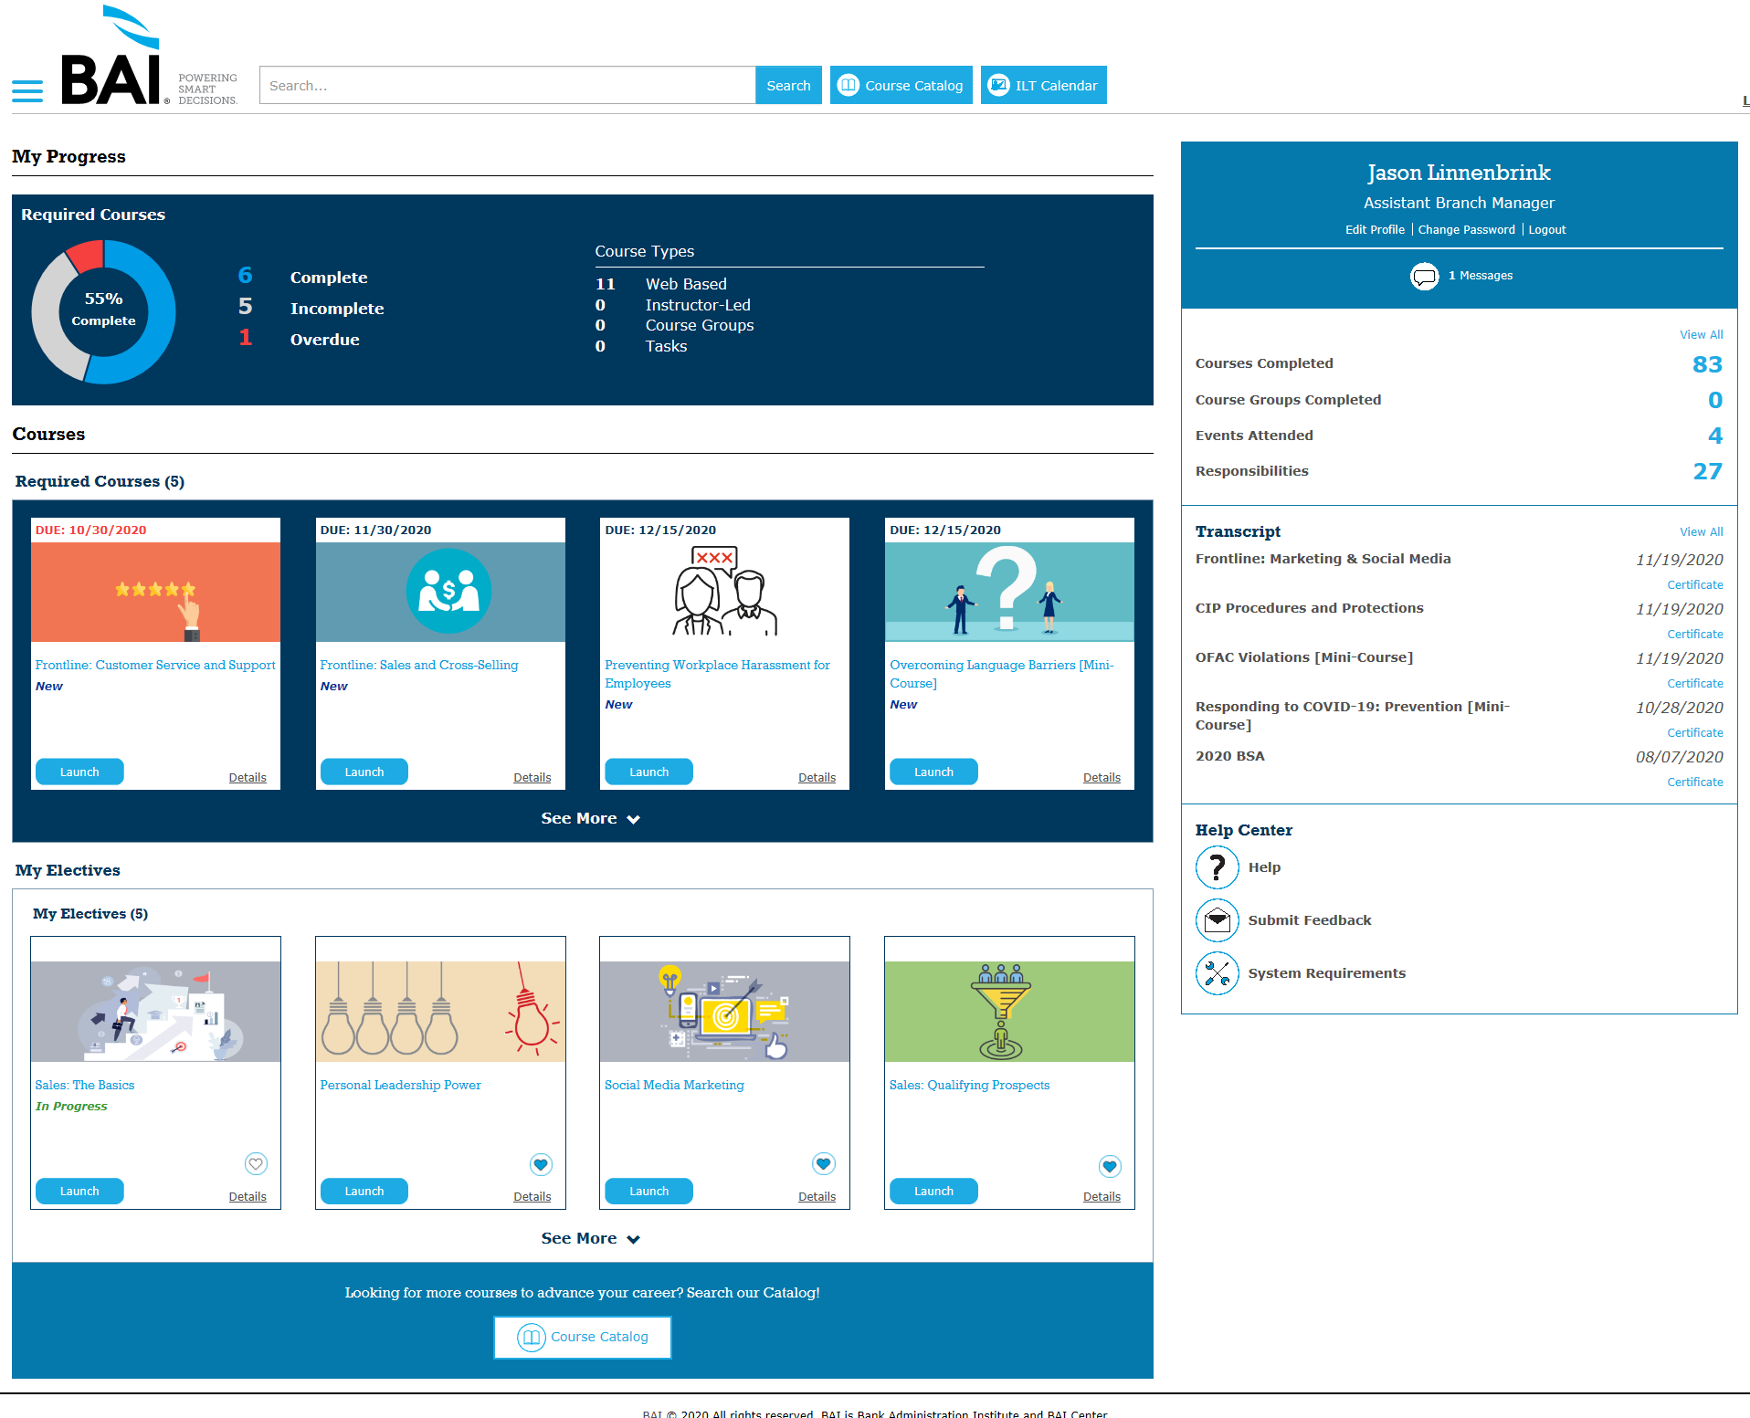
Student Dashboard
Your dashboard is where you can quickly see your progress with required courses, view and launch all assigned courses, and much more. Your view is dynamic and based on what kind of assignment you have and what features your organization is using.

Slide 3
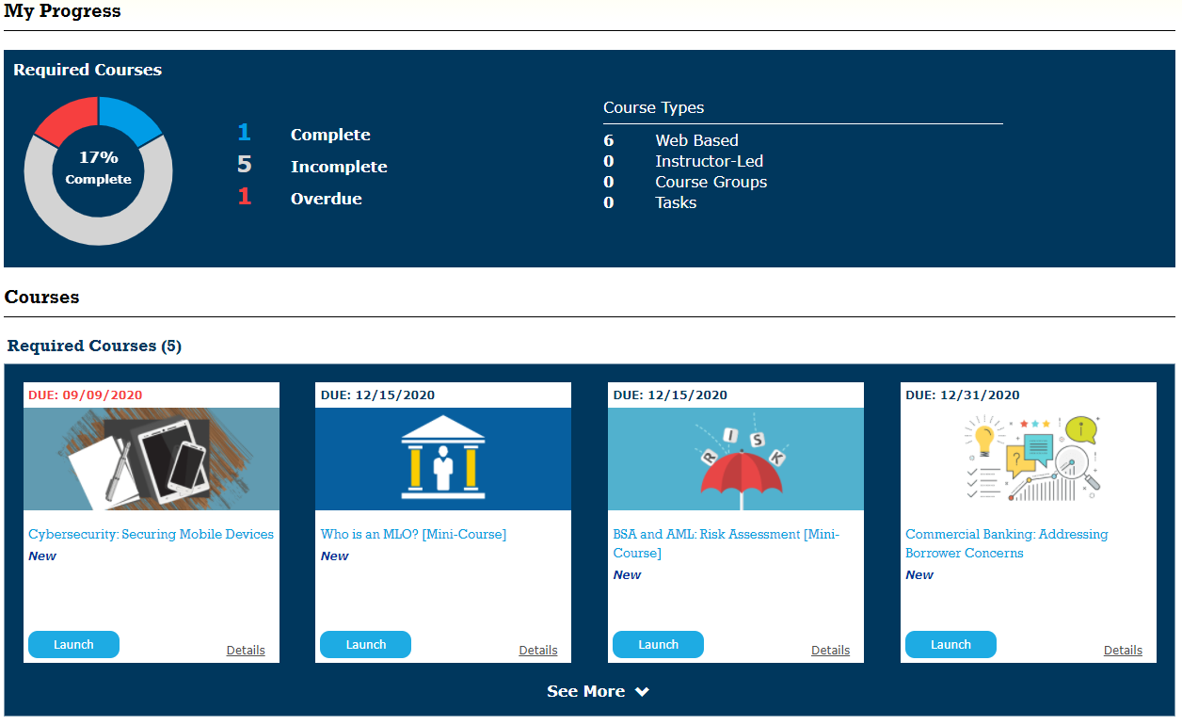
My Progress and Required Courses
My Progress provides an overview of your completion status with all your assigned Required Courses. Below under Required Courses you have quick access to all incomplete courses sorted by Due Date.

Slide 4
Recommended Courses
The Recommended Courses section displays any course assigned to you as recommended instead of required.
All other functionality is the same as the Required Courses section.

Slide 5
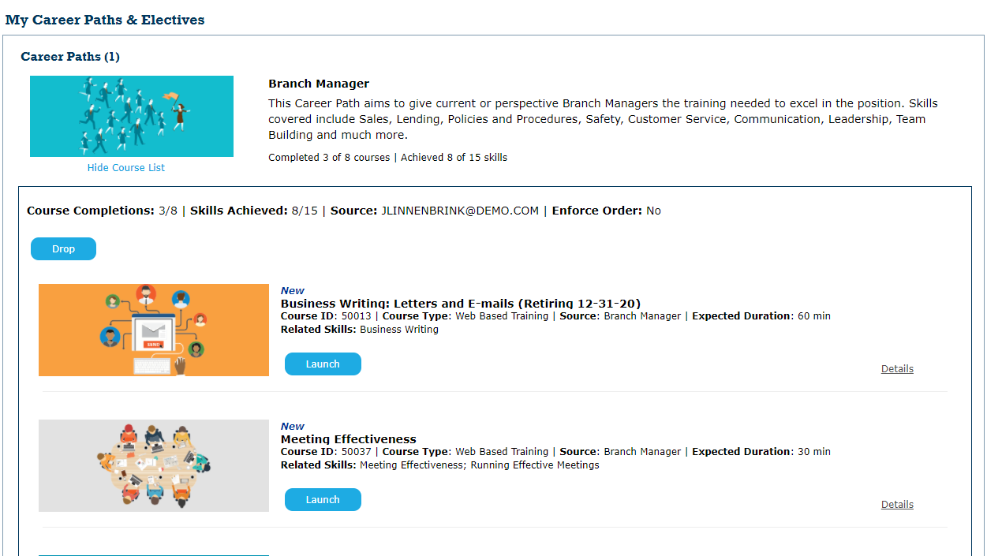
My Career Paths
All Career Paths that are assigned or in-progress will display here
You can click Show Course List to view the details and complete the associated courses
If you have no Career Paths, follow the messaging to see what is available and enroll

Slide 6
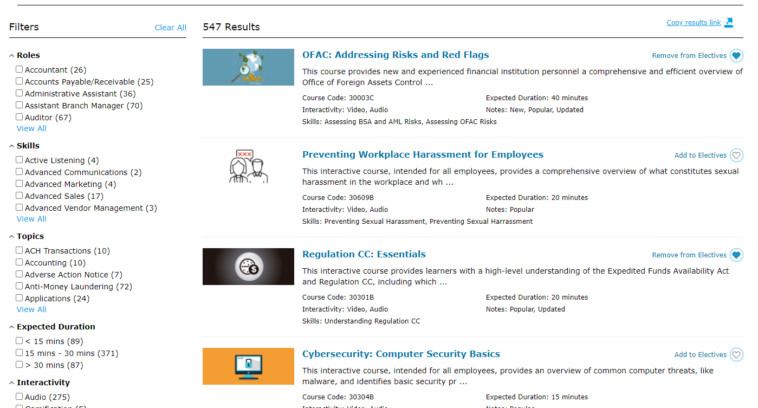
My Electives
This section includes any course you launch that was not assigned
Courses you select by clicking Add to Electives in the Catalog will display here for easy access in the future
You can complete the course or deselect the heart to remove it from My Electives

Slide 7
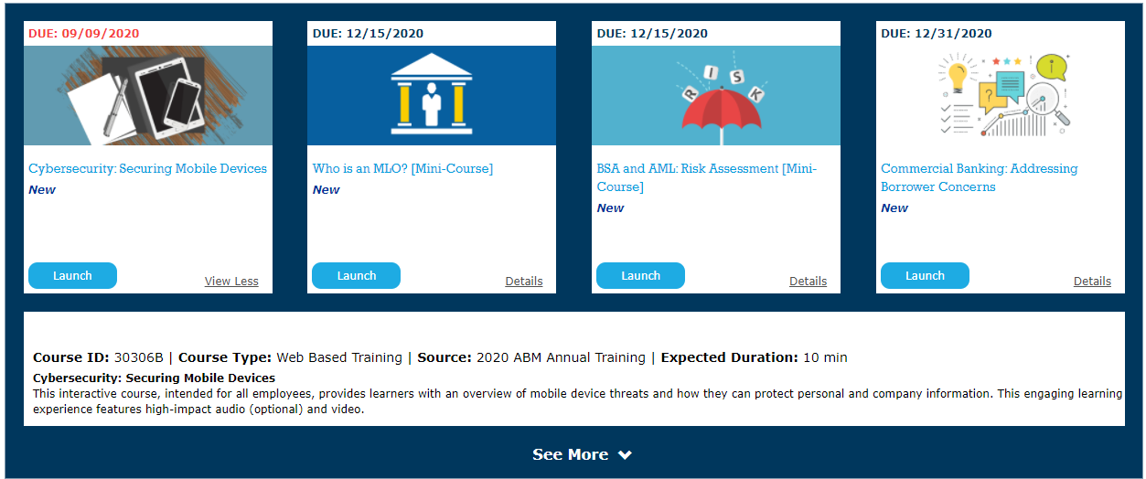
Course Tiles
Due Dates appear in the upper-left-hand corner
Course Title and Enrollment Status show in the middle of the tile
Click Launch to begin the course*
Click Details to find more information about the course
Notes:
*Make sure your pop-up blockers are disabled before you launch a course.

Slide 8
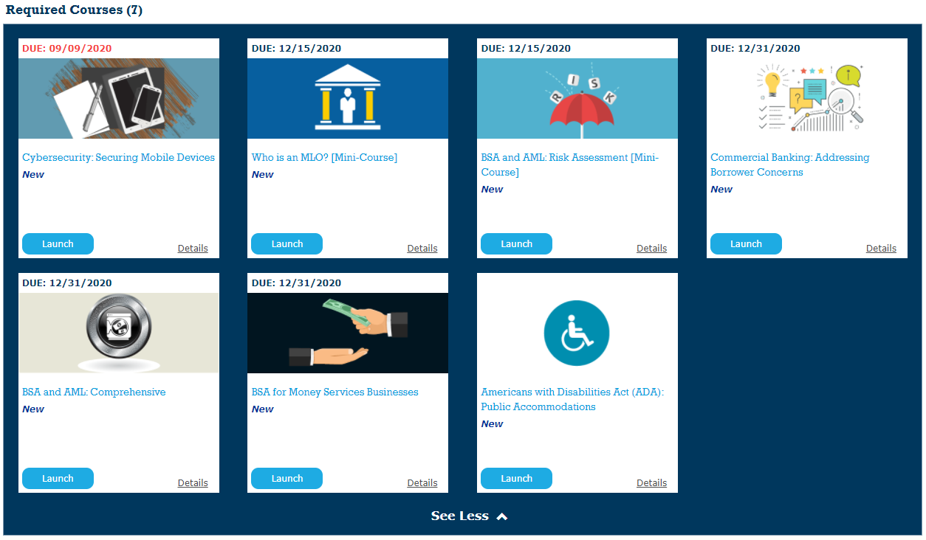
Expandable Course Lists
Up to four courses show in each section
Once the list exceeds that you can click See More to expand
Clicking See Less reduces the section back to the first four courses

Slide 9
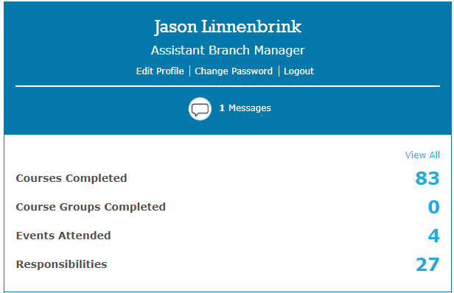
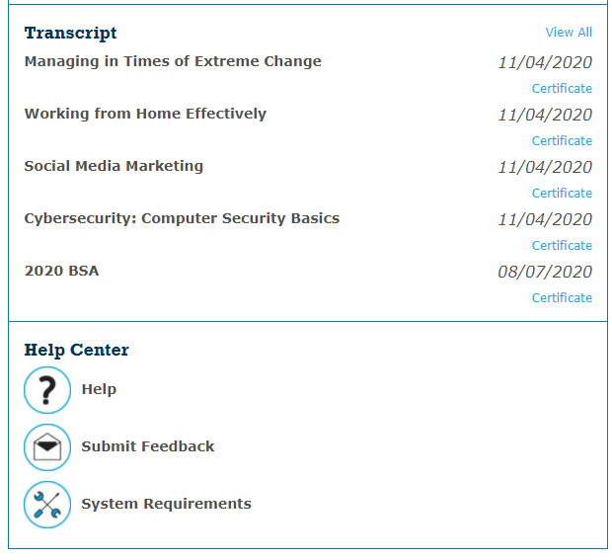
Sidebar
The Sidebar provides a quick view of information and access to helpful resources. Including:
Profile data including the ability to Change Password
Completion Records
Help Center

Slide 10
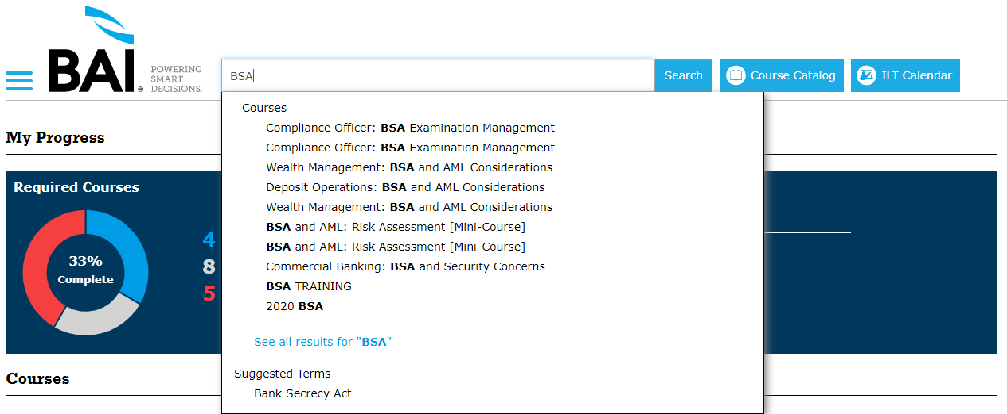
Searching the Catalog
You can search all content available in your account. Use the Search Bar or Course Catalog button at the top of the page to get started.

Slide 11
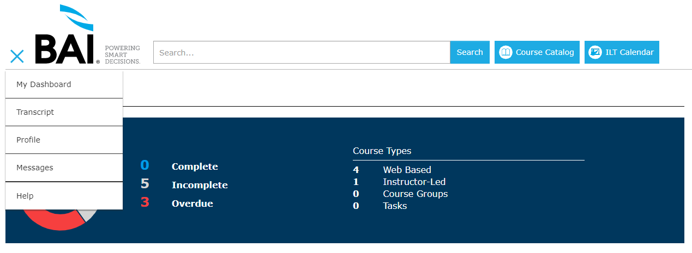
Navigation Menu
The menu is always accessible throughout the BAI Learning Manager
Use it to access other pages of interest
Or quickly return to your dashboard via My Dashboard

Slide 12
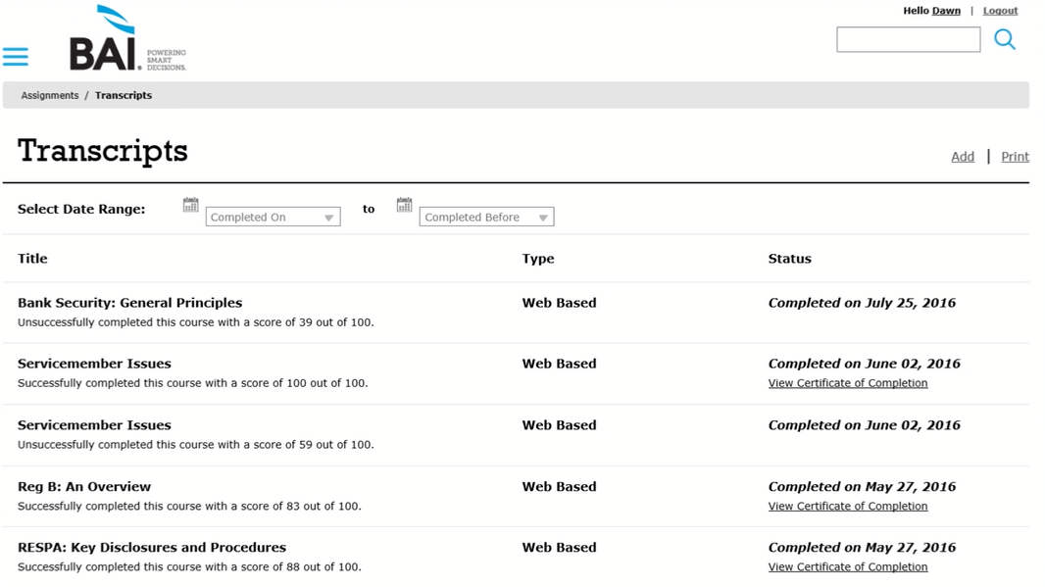
Transcripts
Your transcript can always be found in the navigation menu towards the top of the list.

Slide 13
Help
Visit the Help section in the navigation menu for an overview of the system and frequently asked questions.

